Slide 1
Web Development Using Python Framework
Team Details:
* Drishti Bansal : Roll No.2410993275
Divyanjli Tiwari : Roll No. 2410993272
Milanjot Kaur: Roll No. 2410993294
Himani Batra : Roll No.2410993286
Faculty Coordinator:
Dr. Ratan Lal Gupta
:
Chitkara University Institute of Engineering and Technology,
Chitkara University, Punjab

Slide 2
Table of Contents
Introduction
Problem Statement
Technical Details
Key Features
Project Highlights
Bonus Feature
Conclusion
References/Links used

Slide 3
Introduction
EVENT MANAGEMENT SYSTEM
The Event Management System (EMS) is a web-based platform that helps users create, organize, and manage events easily and efficiently.
It provides features like event creation, ticketing, attendee management and scheduling.
The system targets event organizers, attendees, and managers.

Slide 4
Problem Statement
The Eventora aims to solve various problems that are listed as:
Event Planning Complexity: Managing multiple aspects like registration, ticketing, and event promotion can be overwhelming for organizers.
Solution: Create an automated, scalable Event Management System that simplifies event creation and attendee interaction.
Manual Processes: Reliance on manual systems or spreadsheets is inefficient and prone to errors.

Slide 5
Technical Details
Technologies and Methods used:
FRONTEND:
- HTML : Define the content of the web pages, including the layout, text, images, forms, and links.
- CSS : Used to style and format the HTML content, including layout, fonts, colors, spacing, and positioning.
- JAVASCRIPT : Handle user interactions, manipulate the DOM (Document Object Model), and even communicate with the server asynchronously.

Slide 6
BACKEND:
- FLASK : Lightweight Python web framework for small-scale applications, offering flexibility and simplicity.Handles routing, HTTP requests, template rendering, and database connections.
- DATABASE : SQLite is a lightweight, file-based relational database. It’s a great option for small projects or development environments where a full-fledged database is not necessary.

Slide 7
Key Features
A number of key features that included in the project are as follows:
- User Registration: Attendees can sign up for events via simple
registration forms.
- Ticketing & Payments: Integrated payment gateways for ticket
sales and payments.
- Admin Dashboard: For organizers to manage events, attendees, and view statistics.

Slide 8
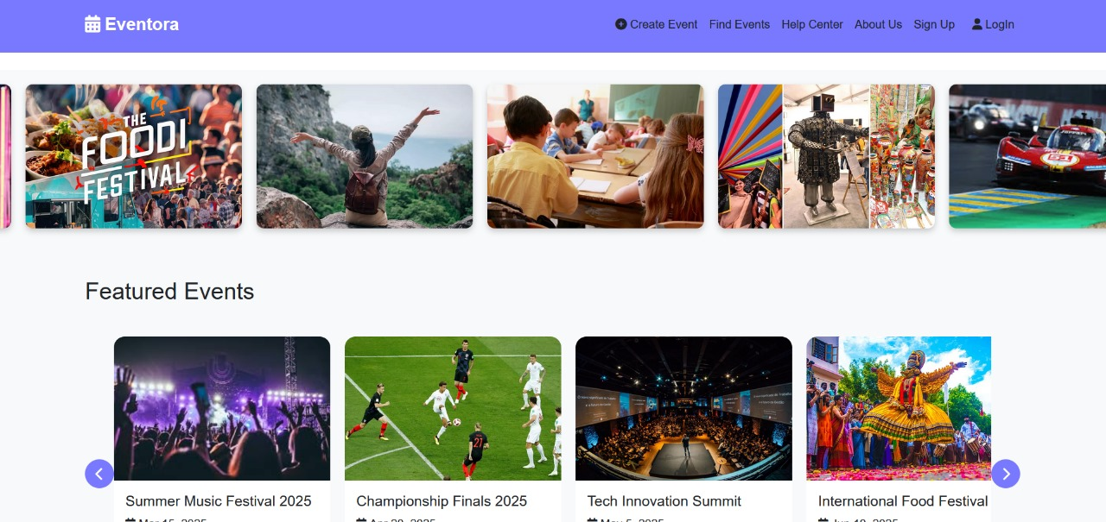
Project Highlights

Slide 9
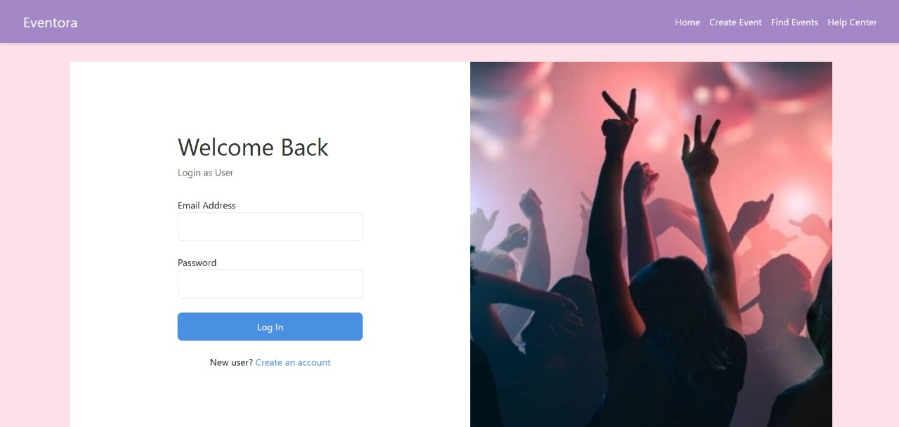

Slide 10
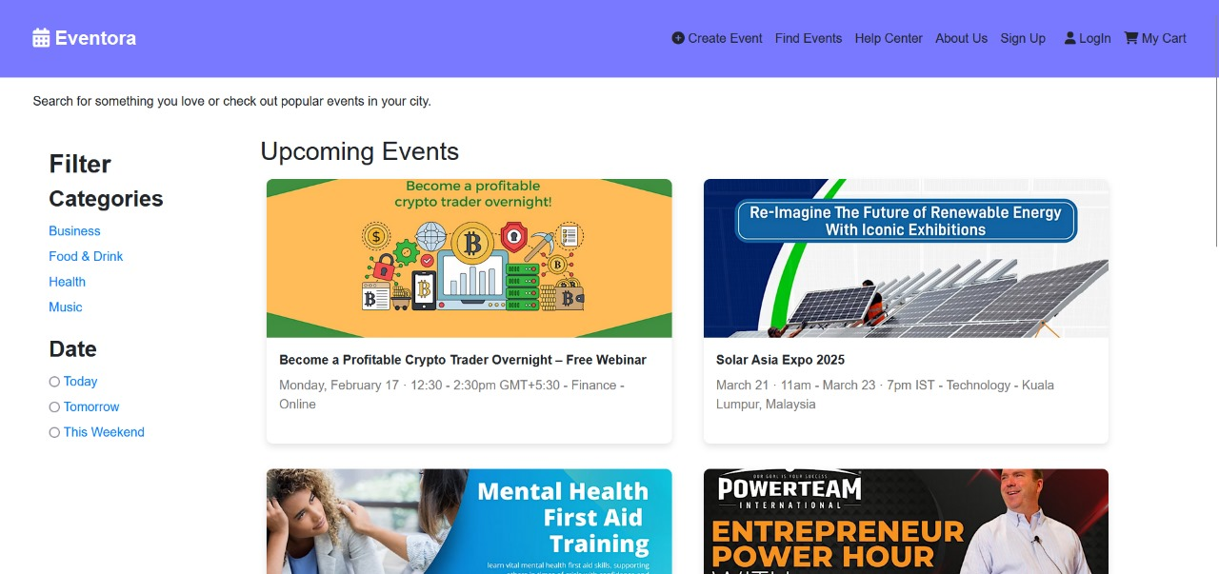

Slide 11
Bonus Feature
A valuable bonus feature in our Event Management System is the event recommendation engine, which provides personalized event suggestions to users based on their interests, previous event attendance, and preferences. By using algorithms to analyze user behavior, the system can recommend upcoming events that match their tastes, improving user engagement.

Slide 12
Conclusion
In conclusion, the Event Management System offers a comprehensive and user-friendly solution for both event organizers and attendees, streamlining the event creation, registration, and ticketing processes. By leveraging Python frameworks like Flask , along with powerful integrations such as payment gateways, notifications, and social media, the system provides a scalable and flexible platform to manage events effectively.

Slide 13
References/Links used
Following is the list of sources and references used in the project.
- https://flask.palletsprojects.com /
https://www.eventbrite.com/
https://www.freepik.com
https://bootstrap.com

Slide 14


